Slide 1
CPU SCHEDULING

Slide 2
CPU scheduling
CPU scheduling is a process which allows one process to use the CPU while the execution of another process is on hold(in waiting state) due to unavailability of any resource like I/O etc, thereby making full use of CPU. The aim of CPU scheduling is to make the system efficient, fast and fair.
Whenever the CPU becomes idle, the operating system must select one of the processes in the ready queue to be executed.
The selection process is carried out by the short-term
scheduler (or CPU scheduler).
The scheduler selects from among the processes in memory that are ready to execute, and allocates the CPU to one of them.

Slide 3
Process execution consists of a CPU execution and IO wait. Process alternates between these two states.
CPU burst: controlled by CPU
IO burst: controlled by IO.

Slide 4
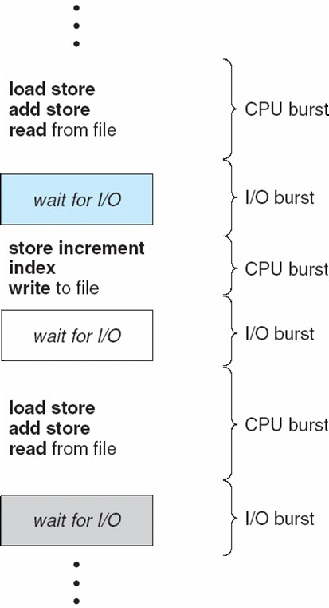
Alternating Sequence of CPU And I/O Bursts

Slide 5
CPU scheduling decisions may take place under the following four circumstances:
When a process switches from the running state to the waiting state(for I/O request or invocation of wait for the termination of one of the child processes).
When a process switches from the running state to the ready state (for example, when an interrupt occurs).
When a process switches from the waiting state to the ready state(for example, completion of I/O).
When a process terminates.

Slide 6
SCHEDULING TYPES
Preemptive:
preemptive scheduling is based on priority where a scheduler may preempt a low priority running process anytime when a high priority process enters into a ready state.
Non-preemptive:
Non-preemptive algorithms are designed so that once a process enters the running state, it cannot be preempted until it completes its allotted time

Slide 7
Scheduling Criteria
CPU Utilization:
Keep the CPU as busy as possible. It range from 0 to 100%. In practice, it range from 40 to 90%.
Throughput:
Throughput is the rate at which processes are completed per unit of time.
Turnaround time:
This is the how long a process takes to execute a process. It is calculated as the time gap between the submission of a process and its completion.
Time Difference between completion time and arrival time.
Turn Around Time = Completion Time - Arrival Time
Waiting time:
Waiting time is the sum of the time periods spent in waiting in the ready queue.
Time Difference between turn around time and burst time. Waiting Time = Turn Around Time - Burst Time

Slide 8
Response time:
Response time is the time it takes to start responding from submission time. It is
calculated as the amount of time it takes from when a request was submitted until the first
response is produced.
Fairness:
Each process should have a fair share of CPU.

Slide 9
Times
Arrival time=the time at which process enter the ready queue or state.
Burst time=time taken by process to get executed on the CPU.
completion time=point of time at which
process completed.
Turn around time=completion time-arrival time.
Waiting time=Turnaround time-burst time

Slide 10
SCHEDULING ALGORITHM
First Come First Serve(FCFS) Scheduling
Shortest-Job-First(SJF) Scheduling
Priority Scheduling
Round Robin(RR) Scheduling
Multilevel Queue Scheduling
Multilevel Feedback Queue Scheduling

Slide 11
Scheduling Algorithm Optimization Criteria
Max CPU utilization
Max throughput
Min turnaround time
Min waiting time
Min response time

Slide 12
FCFS SCHEDULING
first come first serve.
Jobs are executed on first come, first serve basis.
Easy to understand and implement.
Poor in performance as average wait time is high.
FCFS is non preemptive. Once CPU has been allocated to a process that process keeps the CPU until it terminates or IO request comes. This is particularly troublesome for time sharing systems where each user needs to get a share of CPU at regular intervals. It would be disastrous to allow one process to keep CPU for an extended period.
DISADVANTAGE
Convoy effect short process behind long process. All processes are waiting for one big process to get off the CPU. This effect results in lower CPU utilization.

Slide 13
First-Come, First-Served (FCFS) Scheduling
Process | Burst Time
P₁ | 24
P₂ | 3
P₃ | 3
Suppose that the processes arrive in the order: P₁ , P₂ , P₃
The Gantt Chart for the schedule is:
P₁ | P₂ | P₃
0
24
27
30
Waiting time for P₁ = 0; P₂ = 24; P₃ = 27
Average waiting time: (0 + 24 + 27)/3 = 17

Slide 14
FCFS Scheduling (Cont)
Suppose that the processes arrive in the order
P₂ , P₃ , P₁
The Gantt chart for the schedule is:
P₂ | P₃ | P₁
0 3 6
Waiting time for P₁ = 6; P₂ = 0; P₃ = 3
Average waiting time: (6 + 0 + 3)/3 = 3
Much better than previous case
30

Slide 15


First-Come, First-Served (FCFS)
Example: Three processes arrive in order P1, P2, P3.
P1 burst time: 24 P2 burst time: 3 P3 burst time: 3
Waiting Time
P1: 0
P2: 24
P3: 27
P1 | P2 | P3
0
24
27
30
Turnaround Time/Completion Time:
P1: 24
P2: 27
P3: 30
Average Waiting Time: (0+24+27)/3 = (51/3)= 17 milliseconds Average Completion Time: (24+27+30)/3 = 81/3=27 milliseconds

Slide 16
Find out average waiting time and turn around time
Process | Burst time
P1 | 21
P2 | 3
P3 | 6
P4 | 2

Slide 17
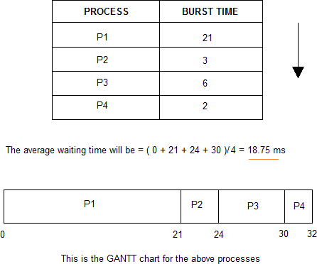
Example: First-Come, First-Served (FCFS)
Average turn around time =107/4=26.75

Slide 18
Find out average waiting time and turn around time
Process | Arrival time | Burst time
P1 | 0 | 4
P2 | 1 | 3
P3 | 2 | 1
P4 | 3 | 2
P5 | 4 | 5

Slide 19
Proc ess | Arrival time | Burst time | CT | TAR | WT
P1 | 0 | 4 | 4 | 4 | 0
P2 | 1 | 3 | 7 | 6 | 3
P3 | 2 | 1 | 8 | 6 | 5
P4 | 3 | 2 | 10 | 7 | 5
P5 | 4 | 5 | 15 | 11 | 6
p1 | p2 | p3 | p4 | p5
0
4
7
8
10
15

Slide 20
First Come First Serve
Process id | A T | BT
1 | 0 | 2
2 | 3 | 1
3 | 5 | 6
Turn around time= Completion Time- Arrival Time
Waiting Time= Turn around Time- Burst Time

Slide 21
First Come First Serve
Process id | A T | BT | CT | TAT | WT
1 | 0 | 2 | 2 | 2 | 0
2 | 3 | 1 | 4 | 1 | 0
3 | 5 | 6 | 11 | 6 | 0
Turn around time= Completion Time- Arrival Time
Waiting Time= Turn around Time- Burst Time

Slide 23


Shortest Job First
Processes with least execution time are selected first. CPU is assigned to process with less CPU burst time.
SJF:
Non-Preemption: CPU is always allocated to the process with least burst time and Process Keeps CPU with it until it is completed.
Pre-Emption: When a new process enters the queue, scheduler checks its execution time and compare with the already running process.
If Execution time of running process is more, CPU is taken from it and given to new process.

Slide 24
Shortest Job First
ADVANTAGES
It gives superior turnaround time performance to shortest process next because a short job is given immediate preference to a running longer job.
Throughput is high.
DIS ADVANTAGES
Starvation may be possible for the longer processes

Slide 25
Shortest Job First
SJF can be premptive or non-preemptive.
A premptive SJF algorithm will preempt the currently executing process if the next CPU burst of newly arrived process may be shorter than what is left to the currently executing process.
A Non-premptive SJF algorithm will allow the currently running process to finish.Preemptive SJF Scheduling is sometimes called Shortest Remaining Time First algorithm

Slide 26

Practice: Shortest Job First (Non Preemption)
P1 burst time: 15 P2 burst time: 8 P3 burst time: 10 P4 burst time: 3
26

Slide 27

Shortest Job First (Non-Preemption)
What if their order had been P4, P2, P3 and P1?
Actual order:
P1 burst time: 15
P2 burst time: 8 P3 burst time: 10 P4 burst time: 3
Waiting Time
P4: 0
P2: 3
P3: 11
P1: 21
Completion Time: P4: 3
P2: 3+8=11
P3: 3+8+10=21
P1: 3+8+10+15=36
Average Waiting Time: (0+3+11+21)/4 = 8.7
Turnaround Time: (3+11+21+36)=71/4=17.75

Slide 28
SHORTEST JOB FIRST (NON-PREEMTIVE)
Process | Arrival time | Burst time
P1 | 1 | 7
P2 | 2 | 5
P3 | 3 | 1
P4 | 4 | 2
P5 | 5 | 8
Find out completion time ,waiting time and turn around time

Slide 29
Proc ess | Arrival time | Burst time | CT | TAR | WT
P1 | 1 | 7 | 8 | 7 | 0
P2 | 2 | 5 | 16 | 14 | 9
P3 | 3 | 1 | 9 | 6 | 5
P4 | 4 | 2 | 11 | 7 | 5
P5 | 5 | 8 | 24 | 19 | 11

Slide 30
Shortest Job First(Preemptive)
Q1. Consider foll. Processes with A.T and B.T
Process |  | A.T | B.T
P1 | 0 |  | 9
P2 | 1 |  | 3
P3 | 2 |  | 9
Cal. Completion time, turn around time and avg. waiting time.

Slide 31
Shortest Job First(Preemptive)
Q1. Consider foll. Processes with A.T and B.T
Process |  | A.T | B.T
P1 | 0 |  | 5
P2 | 1 |  | 3
P3 | 2 |  | 3
P4 | 3 |  | 1
Cal. Completion time, turn around time and avg. waiting time.
0.P1-> 1.P2->2.P2->3.P2->4.P4->5.P3->8.P1

Slide 32
Shortest Job First(Preemptive)
Proc ess | Arrival time | Burst time | CT | TAR | WT
P1 | 0 | 7
P2 | 1 | 5
P3 | 2 | 3
P4 | 3 | 1
P5 | 4 | 2
P6 | 5 | 1
Cal. Completion time, turn around time and avg. waiting time.

Slide 33
Proc ess | Arrival time | Burst time | CT | TAR | WT
P1 | 0 | 7 | 19 | 19 | 12
P2 | 1 | 5 | 13 | 12 | 7
P3 | 2 | 3 | 6 | 4 | 1
P4 | 3 | 1 | 4 | 1 | 0
P5 | 4 | 2 | 9 | 5 | 3
P6 | 5 | 1 | 7 | 2 | 1
P1 | P2 | p3 | p4 | p3 | p3 | p6 | p5 | p2 | p1
0
1
2 3
4 5
6 7 9 13 19

Slide 34
Shortest Job First(Preemptive)
Proc ess | Arrival time | Burst time | CT | TAR | WT
P1 | 8 | 1
P2 | 5 | 1
P3 | 2 | 7
P4 | 4 | 3
P5 | 2 | 8
P6 | 4 | 2
P7 | 3 | 5
Cal. Completion time, turn around time and avg. waiting time.

Slide 35
Proc ess |  | Arrival time |  |  | Burst time |  |  |  | CT |  |  | TAR |  | WT
P1 |  | 8 |  |  | 1
P2 |  | 5 |  |  | 1
P3 |  | 2 |  |  | 7
P4 |  | 4 |  |  | 3
P5 |  | 2 |  |  | 8
P6 |  | 4 |  |  | 2
P7 |  | 3 |  |  | 5
 |  |  | P3 | p7 |  | p6 | p6 | P2 |  | p4 | p1 |  | P4 | P7 | P3 | P5
0 2
3
4
5 6
7 8
9
11
15
21
29

Slide 36
PRIORITY SCHEDULING
The SJF is a special case of general priority scheduling algorithm.
A Priority (an integer) is associated with each process.The CPU is allocated to the process with the highest priority.Generally smallest integer is considered as the highest priority.Equal priority processes are scheduled in First Come First serve order.It can be preemptive or Non-preemptive.
Non-preemptive Priority Scheduling
In this type of scheduling the CPU is allocated to the process with the highest priority after completing the present running process
Advantage
Very good response for the highest priority process over non-preemptive version of it.
Disadvantage
Starvation may be possible for the lowest priority processes

Slide 37
Non pre-emtive priority scheduling
Pr oc es s | Arrival time | Burst time | Priority | CT | TAR | WT
P1 | 0 | 4 | 2
P2 | 1 | 2 | 4
P3 | 2 | 3 | 6
P4 | 3 | 5 | 10
P5 | 4 | 1 | 8
P6 | 5 | 4 | 12
P7 | 6 | 6 | 9
Cal. Completion time, turn around time and avg. waiting time.

Slide 38
Pr oc es s | Arrival time | Burst time | Priority | CT | TAT | WT
P1 | 0 | 4 | 2 | 4 | 4 | 0
P2 | 1 | 2 | 4 | 25 | 24 | 22
P3 | 2 | 3 | 6 | 23 | 21 | 18
P4 | 3 | 5 | 10 | 9 | 6 | 1
P5 | 4 | 1 | 8 | 20 | 16 | 15
P6 | 5 | 4 | 12 | 13 | 8 | 4
P7 | 6 | 6 | 9 | 19 | 13 | 7
 | P1 | p4 | p6 | p7 | P5 | p3 | P2
0 4
9 13 19 20 23
25

Slide 39
Pre -emtive priority scheduling
Pr oc es s | Arrival time | Burst time | Priority | CT | TAR | WT
P1 | 0 | 4 | 2
P2 | 1 | 2 | 4
P3 | 2 | 3 | 6
P4 | 3 | 5 | 10
P5 | 4 | 1 | 8
P6 | 5 | 4 | 12
P7 | 6 | 6 | 9
Cal. Completion time, turn around time and avg. waiting time.

Slide 40
Pr oc es s | Arrival time | Burst time | Priority | CT | TAT | WT
P1 | 0 | 4 | 2 | 25 | 25 | 0
P2 | 1 | 2 | 4 | 22 | 21 | 0
P3 | 2 | 3 | 6 | 21 | 19 | 0
P4 | 3 | 5 | 10 | 12 | 9 | 0
P5 | 4 | 1 | 8 | 19 | 15 | 14
P6 | 5 | 4 | 12 | 9 | 4 | 0
P7 | 6 | 6 | 9 | 18 | 12 | 6
P1 | p2 | p3 | p4 | P4 | p6 | P4 | P7 | P5 | P3 | P2 | P1
0 1 2 3 4 5
9
12
18
19
21
22
25

Slide 41
Round Robin Scheduling
Round Robin is the preemptive process scheduling algorithm.
Each process is provided a fix time to execute, it is called a quantum.
Once a process is executed for a given time period, it is preempted and other process executes for a given time period.
Context switching is used to save states of preempted processes.

Slide 42
Pr oc es s | Arrival time | Burst time |  | CT | TAT | WT
P1 | 0 | 4
P2 | 1 | 5
P3 | 2 | 2
P4 | 3 | 1
P5 | 4 | 6
P6 | 5 | 3
P1 | p2 | p3 | p1 | P4 | p5 | P2 | P6 | P5 | P2 | P6 | P5
0 2
3 4 5
9
12
18
19
21
22
25
Round robin scheduling TIME QUANTUM 2

Slide 43
Pr oc es s | Arrival time | Burst time |  | CT | TAT | WT
P1 | 0 | 4
P2 | 1 | 5
P3 | 2 | 2
P4 | 3 | 1
P5 | 4 | 6
P6 | 5 | 3

Slide 44
Pr oc es s | Arrival time | Burst time |  | CT | TAT | WT
P1 | 0 | 4
P2 | 1 | 5
P3 | 2 | 2
P4 | 3 | 1
P5 | 4 | 6
P6 | 5 | 3
P1 | p2 | p3 | p4 | P5 | p6 | P2 | P5
0 4 8 10 11 15 18 19 21
Round robin scheduling TIME QUANTUM 4

Slide 45
Pr oc es s | Arrival time | Burst time |  | CT | TAT | WT
P1 | 5 | 5
P2 | 4 | 4
P3 | 3 | 7
P4 | 1 | 9
P5 | 2 | 2
P6 | 6 | 3
 | P4 | P5 | P3 | P3 | P4 | P6 | P3 | P2 | P4 | P3
0 1 4 6 9 12 15 18
21
22 25
26
19
Round robin scheduling TIME QUANTUM 3

Slide 46
Multilevel Queue Scheduling
A multilevel queue scheduling algorithm partitions the ready queue in several separate queues, for instance
In a multilevel queue scheduling processes are permanently assigned to one queues. The processes are permanently assigned to one another, based on some property of the process, such as
Memory size , Process priority , Process type
Algorithm choose the process from the occupied queue that has the highest priority, and run that process either
Preemptive or Non-preemptively
Each queue has its own scheduling algorithm or policy.
Possibility I
If each queue has absolute priority over lower-priority queues then no process in the queue could run unless the queue for the highest-priority processes were all empty.
For example, in the above figure no process in the batch queue could run unless the queues for system processes, interactive processes, and interactive editing processes will all empty.
Possibility II
If there is a time slice between the queues then each queue gets a certain amount of CPU times, which it can then schedule among the processes in its queue. For instance;
80% of the CPU time to foreground queue using RR. 20% of the CPU time to background queue using FCFS.
Since processes do not move between queue so, this policy has the advantage of low scheduling
overhead, but it is inflexible.

Slide 47
Multilevel feedback queue-scheduling algorithm
Multilevel feedback queue-scheduling algorithm allows a process to move between queues.
It uses many ready queues and associate a different priority with each queue.
The Algorithm chooses to process with highest priority from the occupied queue and run that process either preemptively or un preemptively. If the process uses too much CPU time it will moved to a lower-priority queue.
Similarly, a process that wait too long in the lower-priority queue may be moved to a higher- priority queue may be moved to a highest-priority queue. Note that this form of aging prevents starvation.
Example:
A process entering the ready queue is placed in queue 0.
If it does not finish within 8 milliseconds time, it is moved to the tail of queue 1. If it does not complete, it is preempted and placed into queue 2.
Processes in queue 2 run on a FCFS basis, only when queue 2 run on a FCFS basis, only when queue 0 and queue 1 are empty.`

Slide 48
Process |  | Queue |  | Burst Time |  | Arrival Time
P1 |  | Q1 |  | 4 |  | 0
P2 |  | Q2 |  | 2 |  | 1
P3 |  | Q2 |  | 3 |  | 2
P4 |  | Q1 |  | 2 |  | 2
P5 |  | Q1 |  | 5 |  | 8
 | Queue |  | Priority(Preemptive) |  | Queue Scheduling
 | Q1 |  | 1 |  | RR (TQ=3)
 | Q2 |  | 2 |  | FCFS
P1 | P4 | P1 | P2 | P5 | P3
0
3
5
6
8
13
16

Slide 49
P1 | P4 | P1 | P2 | P5 | P3
0 3
5
6
8
13
16
Waiting Time P1 : (0-0)+2=2 P2 : 6-1=5
P3 : 13-2=11
P4 : 3-2=1
P5 : 8-8=0
Av. Waiting Time= (2+5+11+1+0)/5
= 19/5
= 3.8

Slide 50
Process | Queue | Burst Time | Arrival Time
P1 | Q1 | 3 | 0
P2 | Q2 | 5 | 2
P3 | Q2 | 6 | 2
P4 | Q1 | 2 | 4
P5 | Q1 | 4 | 5
Queue | Scheduling
Q1 | FCFS
Q2 | SJF(NP)
Queues are scheduled using RR (TQ=5)
P1 | P2 | P4 | P5 | P3 | P5 | P3
0
3
8
10
13
18
19
20

Slide 51
P1 | P2 | P4 | P5 | P3 | P5 | P3
0
3
8
10
13
18
19
20
Waiting time P1 : 0-0=0
P2 : (3-2)=1
P3 : (13-2)+1=12
P4 : 8-4=4
P5 : (10-5)+5=10
Av. Waiting Time=27/5
=5.4

Slide 52
Approaches to Multiple-Processor Scheduling
One approach is when all the scheduling decisions and I/O processing are handled by a single processor which is called the Master Server and the other processors executes only the user code. This is simple and reduces the need of data sharing. This entire scenario is called Asymmetric Multiprocessing

Slide 53
A second approach uses Symmetric Multiprocessing where each processor is self scheduling. All processes may be in a common ready queue or each processor may have its own private queue for ready processes. The scheduling proceeds further by having the scheduler for each processor examine the ready queue and select a process to execute

Slide 54
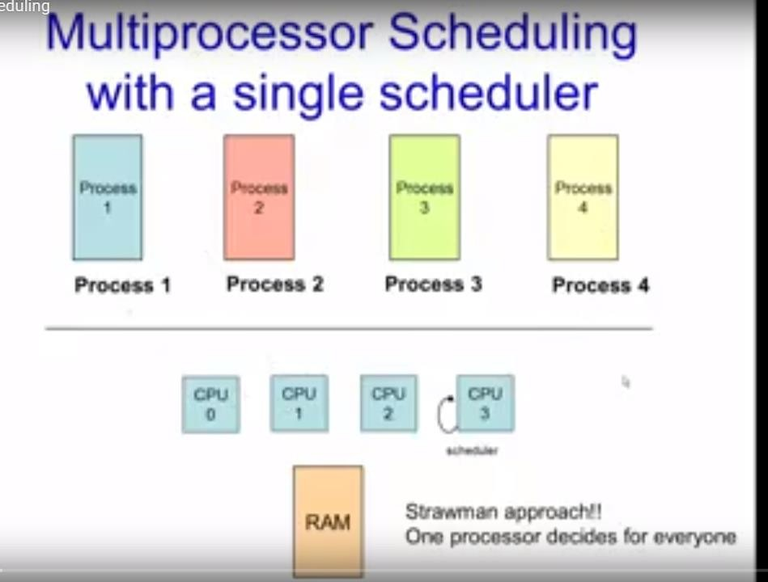

Slide 55
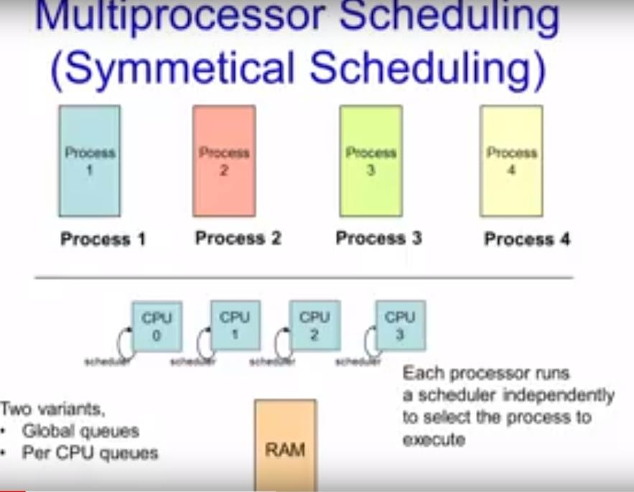

Slide 56
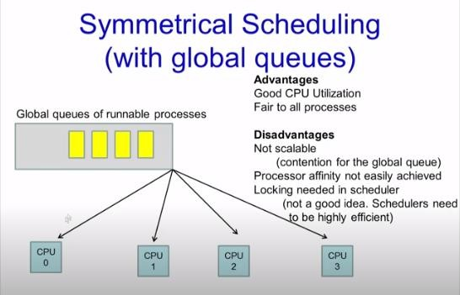

Slide 57
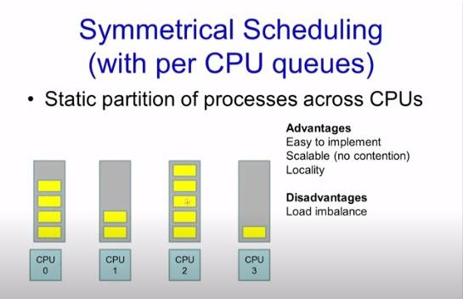

Slide 58
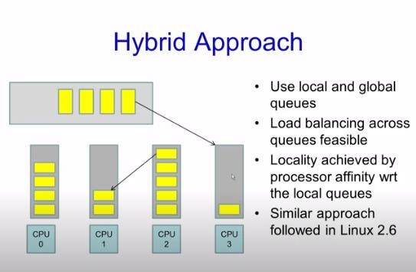

Slide 59
Processor Affinity
Processor Affinity means a processes has an affinity for the processor on which it is currently running.
When a process runs on a specific processor there are certain effects on the cache memory. The data most recently accessed by the process populate the cache for the processor and as a result successive memory access by the process are often satisfied in the cache memory. Now if the process migrates to another processor, the contents of the cache memory must be invalidated for the first processor and the cache for the second processor must be repopulated. Because of the high cost of invalidating and repopulating caches, most of the SMP(symmetric multiprocessing) systems try to avoid migration of processes from one processor to another and try to keep a process running on the same processor. This is known as PROCESSOR AFFINITY.

Slide 60
There are two types of processor affinity:
Soft Affinity – When an operating system has a policy of attempting to keep a process running on the same processor but not guaranteeing it will do so, this situation is called soft affinity.
Hard Affinity – Hard Affinity allows a process to specify a subset of processors on which it may run. Some systems such as Linux implements soft affinity but also provide some system calls like sched_setaffinity() that supports hard affinity.

Slide 61
Load balancing
Load Balancing is the phenomena which keeps
the workload evenly distributed across all processors in an SMP system. Load balancing is necessary only on systems where each processor has its own private queue of process which are eligible to execute. Load balancing is unnecessary because once a processor becomes idle it immediately extracts a runnable process from the common run queue.
On SMP(symmetric multiprocessing), it is important to keep
the workload balanced among all processors to fully utilize the benefits of having more than one processor else one or more processor will sit idle while other processors have high workloads along with lists of processors awaiting the CPU.

Slide 62
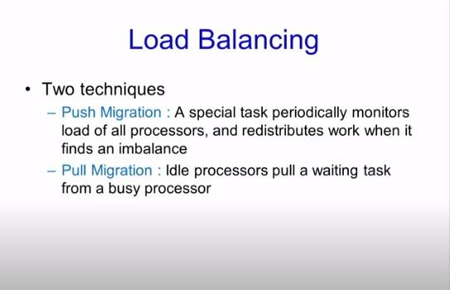
LOAD BALANCING

Slide 63
Multicore Processors
Recently computer hardware has been to place multiple processor cores on the same physical chip, resulting in a multicore processor.
When a processor accesses memory, it spends a significant amount of time waiting for the data to become available. This situation, known as a memory stall.
To remedy this situation, many recent hardware designs have implemented multithreaded processor cores in which two (or more) hardware threads are assigned to each core. That way, if one thread stalls while waiting for memory, the core can switch to another thread.
There are two ways to multithread a processing core: coarse grained and fine-grained multithreading.
With coarse-grained multithreading, a thread executes on a processor until a long- latency event such as a memory stall occurs. Because of the delay caused by the long- latency event, the processor must switch to another thread to begin execution. However, the cost of switching between threads is high, since the instruction pipeline must
be flushed before the other thread can begin execution on the processor core. Once this new thread begins execution, it begins filling the pipeline with its instructions. Fine-
grained (or interleaved) multithreading switches between threads at a much finer level of granularity—typically at the boundary of an instruction cycle. However, the architectural design of fine-grained systems includes logic for

Slide 64
Process types
erminating processes: A terminating process may be considered as one that runs and then exits erminates). We are interested in the amount of time that it takes it to run to completion.
s deadline is the time that at which it should complete all its work s compute time is the amount of CPU time it needs.
onterminatingprocesses: For processes such as video and audio servers as well as editors, we are ot interested in the terminating time of these processes but rather in the time between events.
or example, we would like our audio server to fill a 4K byte audio buffer every 500 milliseconds or
e would like our video server to provide a new video frame every 33.3 milliseconds. For these rocesses, the compute time is the CPU time that the process needs to compute its periodic event a e deadline is the time at which it must have the results ready. Non terminating processes may be ivided into two classes:
Periodic: A periodic process has a fixed frequency at which it needs to run. For example, a vide decompressor may have to run 30 times per second at 33.3 millisecond intervals.
Aperiodic: Aperiodic processes have no fixed, cyclical, frequency between events. Event interru may occur sporadically and event computation times may vary dramatically. For purposes of
scheduling, we use the shortest period and the longest computation time to play it safe.

Slide 65
Real-time operating systems
Priority-based scheduler
Guaranteed maximum time to service interrupts
Ability to ensure that processes are fully loaded into memory and stay in memory
Consistent and efficient memory allocation
Preemptable system calls
Real-time systems are systems that carry real-time tasks. These tasks need to be performed immediately with a certain degree of urgency. In particular, these tasks are related to control of certain events (or) reacting to them. Real-time tasks can be classified as hard real-time tasks and soft real-time tasks.
A hard real-time task must be performed at a specified time which could otherwise lead to
huge losses. In soft real-time tasks, a specified deadline can be missed. This is because the task can be rescheduled (or) can be completed after the specified time,
In real-time systems, the scheduler is considered as the most important component which is typically a short-term task scheduler. The main focus of this scheduler is to reduce the response time associated with each of the associated processes instead of handling the deadline.

Slide 66
Real time scheduling
Real time scheduling is of two types: Soft Real-Time scheduling which does not guarantee when when a critical real-time process will be scheduled; Hard Real- Time scheduling in which the process must be scheduled before the deadline. two real time scheduling algorithms are: rate monotonic scheduling and earliest deadline first.point to remember here:
The foremost is that the processes are
considered periodic i.e., the process will repeat itself after a fixed period of time. The period of a process is denoted by p. The next characteristic is the processing time t i.e., the time for which the process requires the CPU within each period. In other words processing time refers to the burst time. The final characteristic is the deadline d, i.e., the time before which the process must be serviced.

Slide 67
Rate monotonic
In rate-monotonic scheduling algorithm a static priority policy with preemption is used. Whenever a high priority process arrives it will preempt a lower priority process. Every process gets the priority according to its period. Lower the period higher is the priority. Also, the processing time remains the same in each period.

Slide 68
Earliest deadline first
The second algorithm under real time scheduling is Earliest Deadline First Scheduling. This algorithm assigns priority to the process based on the deadline. Earlier the deadline, higher is the priority. Thus, the priorities keep on changing in this scheduling.

